Slide 1
Transitioning to Post-Quantum Cryptography: Strategies and Tools
CS458 - Project
Team 17

Slide 2
Introduction
Brief overview of quantum computing's impact on cryptography.
Organizations must adopt quantum-safe solutions to protect data.

Slide 3
Parts
Chapter 1: Introduction
Chapter 2: Cryptography Inventory tool
Chapter 3: Crypto agility and migration planning
Chapter 4: Crypto-Agility simulator tool
Chapter 5: Conclusions

Slide 4
Chapter 1: Introduction
Important Points
Quantum computing threatens current cryptography, requiring a shift to quantum-safe algorithms.
Key strategies include HNDL, Cryptographic Agility, and PQC.
Organizations must ensure interoperability, follow compliance, and adopt a technology roadmap.
NIST, EU guidelines, and the PQC Migration Handbook provide steps for a smooth transition.

Slide 5
Concepts Explained
Quantum Computing: Advanced computing that can break current encryption.
HNDL: Storing encrypted data now for future decryption with quantum power.
Cryptographic Agility: Ability to switch encryption algorithms easily.
PQC: Encryption resistant to quantum attacks.
Interoperability: Systems working together without compatibility issues.
Compliance: Adhering to security laws and industry standards.
Technology Roadmap: Plan for adopting and integrating new encryption methods.
NIST: U.S. guidelines for transitioning to quantum-safe cryptography.
EU Guidelines: Europe’s strategy for PQC adoption and risk management.
PQC Migration Handbook: Practical steps for implementing quantum-safe encryption

Slide 6
Part 2
Cryptographic Asset Inventory Tool
Purpose: Identify and manage cryptographic vulnerabilities.
Key Features:
Scans source code folders.
Detects weak cryptographic primitives.
Risk assessment with severity ranking.
Database storage and reporting.

Slide 7
Tool Usage
Scanning a Folder:
Browse to select a folder and start scanning.
Starting the Tool:
Save and run CryptoInventoryTool.py.
Viewing Results:
Display file paths, issues, and severity.
Printing Statistics:
Summary of files scanned and vulnerabilities detected.
Clearing Findings:
Reset results for new scans.

Slide 8
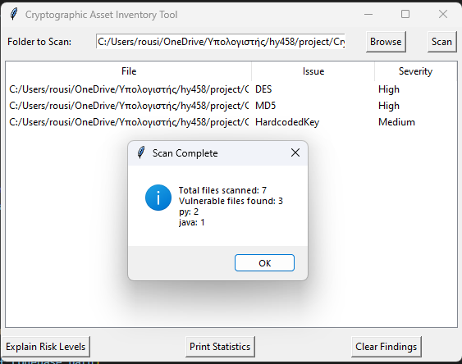

Slide 9
Part 3
Case Study: TechServe Ltd.

Slide 10
Step 1: Assessment
Email Encryption: Uses deprecated TLS 1.0, vulnerable to downgrade attacks.
File Encryption: AES-128 needs better key rotation; should transition to AES-256.
User Authentication: SHA-1 is weak due to collision attacks, risking password security.
VPN Encryption: Uses outdated DES, which is easily crackable.

Slide 11
Step 2: Prioritization
Key Criteria: Impact on data security, GDPR compliance, and password protection.
High Priority: Replace VPN encryption and upgrade password hashing to SHA-256.
Medium Priority: Upgrade TLS from 1.0 to 1.2 or higher.
Low Priority: Transition file encryption to AES-256.

Slide 12
Step 3: Implementation Planning
Replacements:
Upgrade VPN to AES-256,
Authentication to SHA-256,
TLS to 1.2
File encryption to AES-256 with key rotation.
Phase 1: Secure VPN for remote workers.
Phase 2: Implement SHA-256 for password hashing.
Phase 3: Upgrade TLS on email servers.
Phase 4: Improve file encryption policies.

Slide 13
Step 4: Testing
Crete python files for the replacements
IPsec with AES-256
SHA-256
TLS 1.2
AES-256
Run to tool to scan vulnerabilities
Found none

Slide 14
Step 5: Deployment
Phase 1: Schedule downtime and upgrade VPN to IPsec AES-256.
Phase 2: Migrate SHA-1 to SHA-256, enforce strong password policies.
Phase 3: Upgrade TLS to 1.2/1.3, test email deliveries.
Phase 4: Transition files to AES-256 with key rotation.

Slide 15
Step 6: Monitoring
Continuous Monitoring: Use automated tools (e.g., Splunk) to track performance and vulnerabilities.
Regular Audits: Review VPN logs and password strength.
Compliance Checks: Conduct quarterly reviews for GDPR and other regulations.

Slide 16
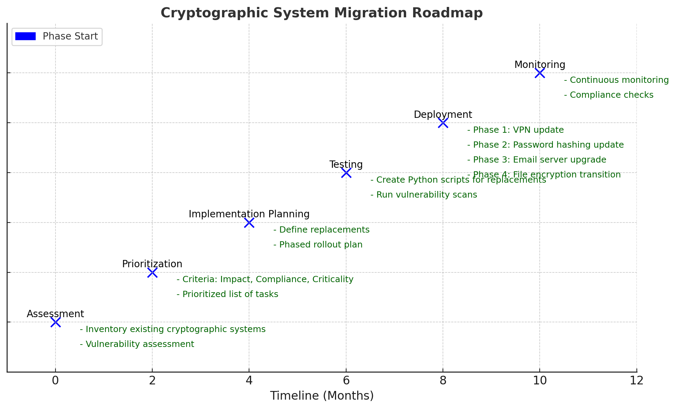
RoadMap

Slide 17
Part 4: Crypto Agility Simulator Development
The Cryptographic Vulnerability Simulator
Analyzes source code for weak cryptographic implementations
Retrieves vulnerabilities from the Crypto Inventory database
Provides fix suggestions through an interactive GUI.

Slide 18
Prerequisites
Before using the simulator, ensure that:
The CryptoInventoryTool has been executed to scan files and store vulnerabilities in crypto_inventory.db.
The simulator script is available and correctly configured.
Python and required libraries (sqlite3, tkinter) are installed.

Slide 19
Running The Simulator
Open a terminal or command prompt.
Navigate to the directory containing the simulator script.
Run the script using: python crypto_simulator.py
The simulator window will launch, displaying a table of vulnerable files.

Slide 20
Using The Simulator
Viewing Vulnerabilities:
The main window displays a list of files, cryptographic issues, and their severity levels.
The table provides an overview of all discovered vulnerabilities.
Checking Suggested Fixes:
Double-click any file entry in the list to view recommended manual fixes.
A pop-up window will provide a brief description of what changes are needed.
Interpreting Severity Levels:
High: Immediate action required to prevent security risks.
Medium: Should be addressed soon to enhance security.
Low: Non-critical but recommended for best practices.

Slide 21
Compliance Monitoring
The tool categorizes vulnerabilities by severity to help prioritize fixes.
Users can address high-risk issues first to maintain compliance with security best practices.

Slide 22
Lessons Learned
Plan Early: Delaying PQC adoption increases risks.
HNDL Risk: Encrypted data today may be decrypted later.
Test Before Deployment: Ensure cryptographic changes are secure.
Continuous Security: Regular monitoring and updates are essential.
Interoperability: New encryption must integrate smoothly with existing systems.

Slide 23
Conclusion
Quantum computing poses a threat to current cryptography.
Organizations must plan for a transition to post-quantum cryptography.
Guidelines from NIST and the European Commission help ensure readiness.
Continuous monitoring and compliance are key to long-term security.
Flexible systems enable smooth migrations

